Slide 1

R Project Predictive Analysis of Anime Data (Movie/Web series)
Created by: Rahul Kumar

Slide 2

Aim of the project
we need to predict the conditions affecting the “Rating” of Anime movie or web series for “Anime” dataset.
The main goal of this project is to use this dataset to develop a Linear Regression Business model in R-Studio and forecast the "Rating." Find the important variables, interpret them, and make practical business recommendations. It will help us with the launching of our next anime film/web series, which will be extremely popular.

Slide 3
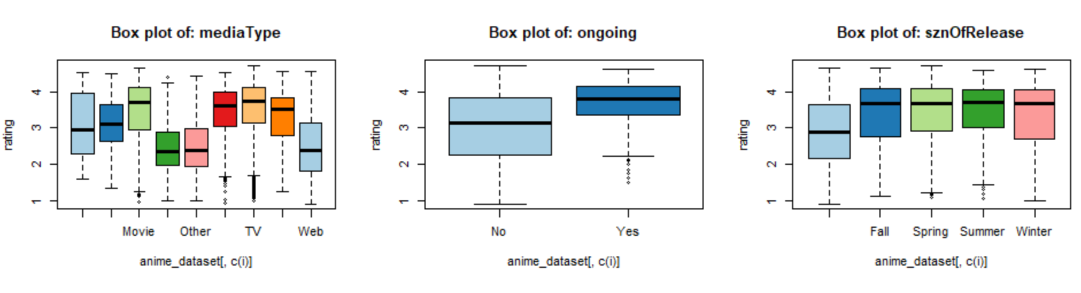
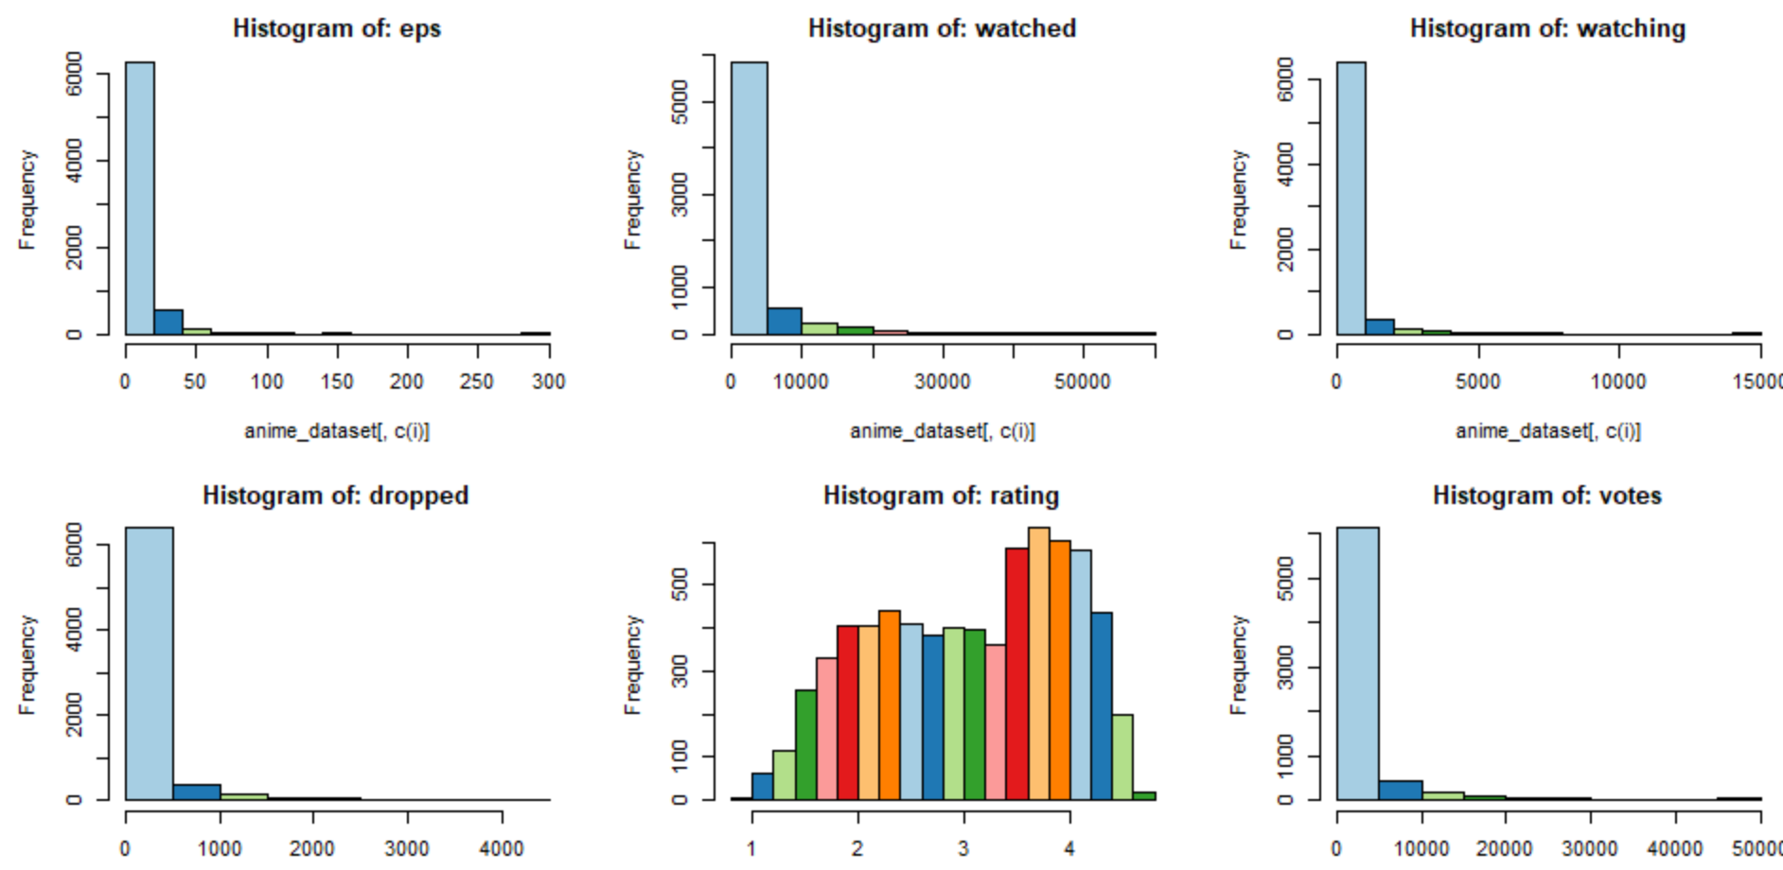
Data Visualization
As we can see in histogram plot that each continuous columns are highly positively skewed except “Rating” column. So, we need log transform to make those data normally distributed which will help us to increase the accuracy of the model.

Slide 4
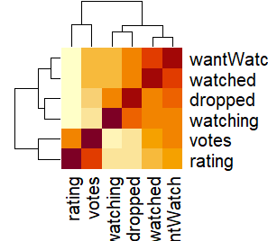
Bivariant Analysis
Correlation Test:- After log transformation we have found that "votes" column are strongly correlated with the target variable column.
Annova Test:- “MediaType” & “ongoing” categorical columns are strongly correlated with “Rating” column.(cause, p-Vaue<0.05)

Slide 5
Significant Variables
Among the 15 Independent variables, the variables which were found to be most significant in final model are as follows:-
Votes: -The number of votes that contribute to the ratings received by different anime.
MediaType:-Format of publication of the anime releases (Web/DVD special/Movie/TV special/TV).

Slide 6
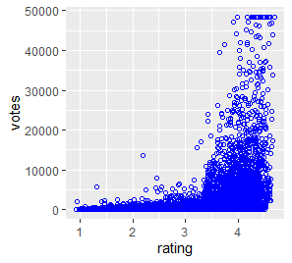
Votes vs rating
It has been observed from the above curve that “Votes” is increasing with increase of “Rating”. So , these two columns are positively correlated. Increasing rate of votes help to increase the rating of the anime series which makes it more popular than others.

Slide 7
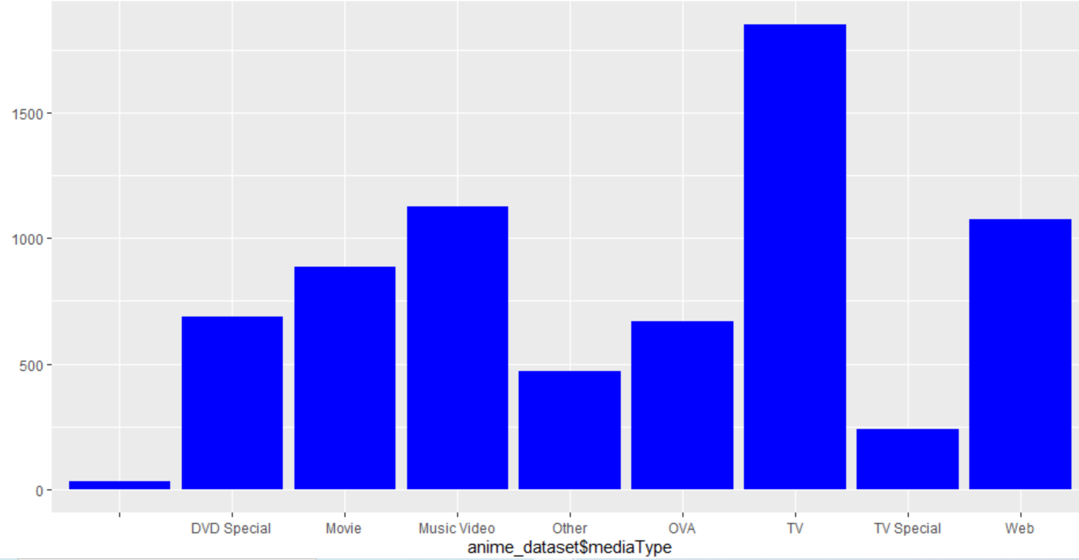
MediaType Vs rating
Web and Movie under mediaType category are most popular according to our final model. Those type have more rating value and popularity than others which has been observed from above chart.

Slide 8
Conclusions
It was found from MAPE (Mean and Median error percentage) that our regression model is predicting the outcome 82.06 %(Mean) & 88.02 %(Median) accurately and error percentage is varying from 12% to 18% which is pretty good for prediction model.
The R-square value is found to be 0.583 and adjusted R-square value is 0.5828. As these values are between 0.5 to 0.95, so this is good predictive model.

Slide 9

Business Recommendations
If movies would release on mediaType(Web/Movie/) There would more chance to get more rating as compared to these MediaType (TV special/TV/DVD special), because most of young generation prefer to watch on web.

Slide 10

Thank you

